Slide 1
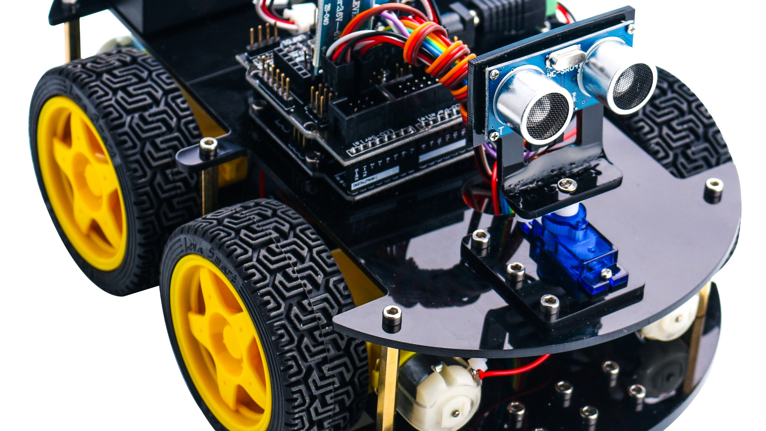
A robot tracking Person
A robot which follows a person by tracking his voice by using Amazon Alexa and let the person know about obstacles in way.

Slide 2
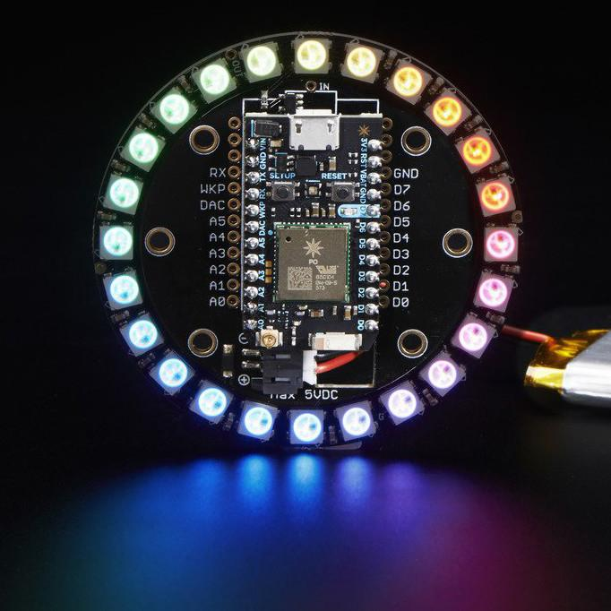
Equipments needed for this project
Raspberry pi Model 3B+
Photon particle
Ultrasonic sensor
SparkFun Dual H-Bridge motor drivers L298
DC motor generic
Breadboard generic
Connectors or jumper wires
Robot classic kit or Car chassis kit
Software apps and online services
OpenCV, IFTTT Alexa, Robo control(WP8), Robo Control(Android)
Hand tools
Python

Slide 3
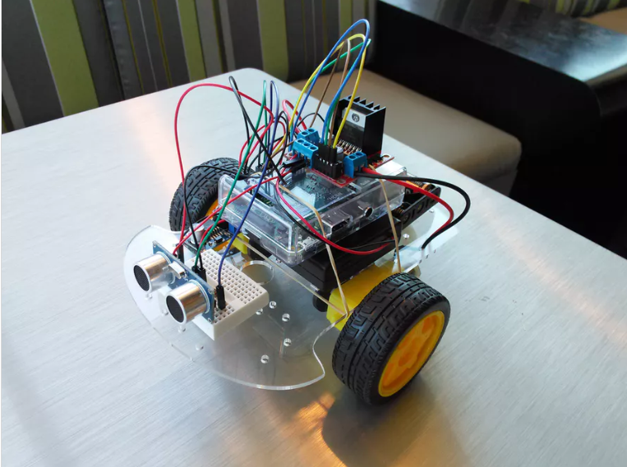
So I am going to divide my project into 2 components
By moving the robo car to move and dodge any obstacle that comes it in the way by using ultrasonic sensors with the help of raspberry pi model 3B+
So, Raspberry pi is the main controller of the robot car, the ultrasonic connected to the pi will guide the vehicle to make turn and stop and reverse the direction.
There is one main component used here that is motor driver as we all know that raspberry pi cannot supply as much as current required to drive the motor
So I are programming raspberry pi by using python IDLE and the library involved in the code for this is GPIO.Rpi
There are 4 pins in the ultrasonic sensor Vcc, GND, Echo, Trigger
So Vcc will be connected to the powersupply and GND with ground and the left two will connect to the GPIO pins.

Slide 4
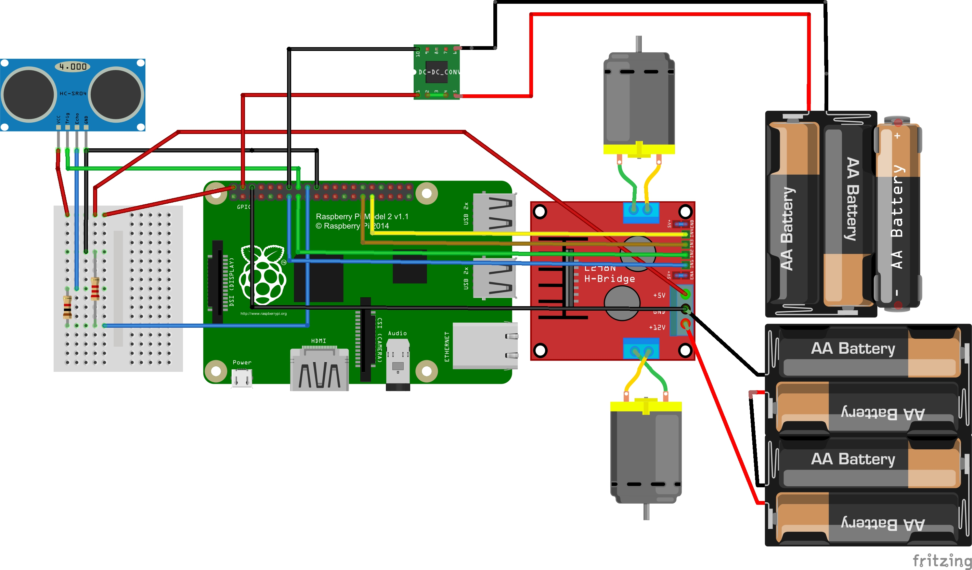
So let’s start with the connections,
Make sure that Vcc pin of each component i.e. Pi, motor driver, ultrasonic sensor are connected to the common terminal, same as with the ground.
Now we need to configure L293D motor controller IC.

Slide 5
So what I am going to do is I will take the readings from ultrasonic sensors
And will design a maze by using Q learning so that robot already knows that
There is an obstacle in front of it. In this way these can be used to clean our
House or can be used in bars for serving the drinks or any other purposes
The next thing is that I will use the photon particle and connect it with alexa or crotona and I will control this robot using verbal commands this thing is possible with raspberry pi but I will use the photon particle as I want the user to choose that which task he wants the robot to perform like we did by creating the html page
I am going to add more things like I will program in a way that after completing the task robot will send a notification that task is finished.

